Slide 1
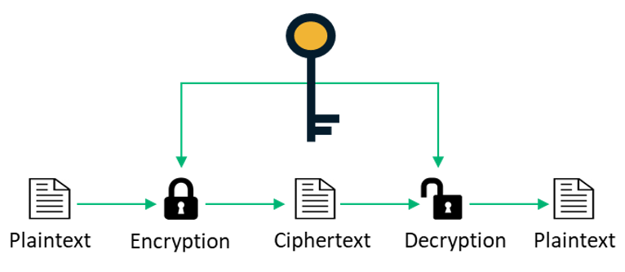
AES Algorithm
An encryption algorithm by Rijndael

Slide 2
Abstract
The Research objective is to explore the design of Advanced Encryption Standard (AES). AES is a symmetric block cipher chosen by U.S government to protect classified information. The National Institute of Standards and Technology (NIST) has initiated the process AES to develop a Federal Information Processing Standard (FIPS) with the replacement of Data Encryption Standard (DES) expired in 1998. NIST has solicited candidate algorithms for inclusion in AES, resulting in fifteen official candidate algorithms of which Rijndael was chosen as the Advanced Encryption Standard.
Advanced Encryption Standard can be programmed in a software and can be implemented on hardware. AES is a subset of However Field Programmable Gate Arrays (FPGAs) offer a quicker, more customizable solution.
This report will give you a clear explanation on how the AES encryption is done using a Hardware Descriptive language(HDL) VHDL. And the working of AES, steps involved in it.
Hardware Descriptive Language : VHDL
Software : Xilinx 14.7

Slide 3
Introduction
Advanced Encryption Standard (AES) is also known as Rijndael algorithm (its original name) is a specification for encryption of electronic data. This algorithm is a supersedes Data Encryption Standard (DES), which was published in 1977, which was started to become vulnerable to brute-force attacks in 1997. In 1997 the NIST has announced the need for an alternative of the DES. This announcement followed a five-year standardization process in which fifteen competing designs were presented and evaluated. AES became effective as a U.S. federal government standard on May 26, 2002, after approval by the U.S. Secretary of commerce.
AES is a symmetric block cipher algorithm that can encrypt and decrypt the information. AES is implemented in both software and hardware throughout the world to encrypt the sensitive data. The encryption is a process of converting the plain text to cipher text. Decryption is a process of converting cipher text to plain text. This AES cryptographic algorithm is capable of encryption/decryption of plain-text with the help of keys 128, 192, 256-bit length with 128-bit size of plaintext.

Slide 4
Working of AES
This encryption algorithm takes an input of 128-bit length plain text with key of length any of the mentioned 3 sizes and outputs a cipher text of 128-bit length same size of plaintext.
AES algorithm can work with different sizes of key lengths 128, 192, and 256-bit key lengths. As we have mentioned that AES symmetric block cipher algorithm it uses the same key for both and encryption and decryption, divides the data into blocks i.e., matrix having each column of 32 bits(1 word or 4 bytes).
Each type of encryption includes 128-bit blocks. The difference lies in the length of the key. As the longest, the 256-bit key provides the strongest level of encryption. With a 256-bit key, a hacker would need to try 2²⁵⁶ different combinations to ensure the right one is included.

Slide 5
Working of AES
Depending on the key lengths number of rounds in the encryption are divided as show below:
128-bit – 10 rounds
192-bit – 12 rounds
256-bit – 14 rounds
And in encryption any key size we are having one pre-round.

Slide 6
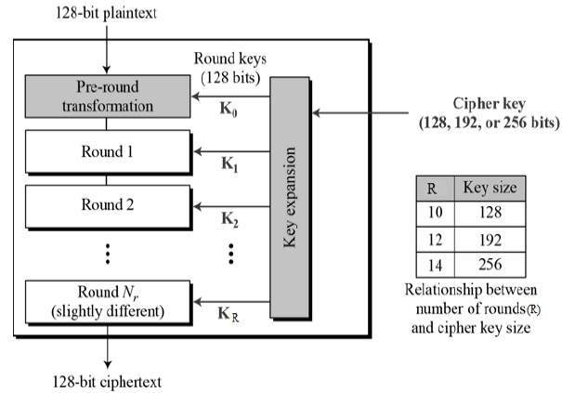
Block diagram of AES

Slide 7
Rounds in AES
As mentioned in the previous slide the depending on the size of the key length the number of rounds are decided.
In this presentation, we are going to deal with 128-bit key length with 10 rounds and one pre-round.
Each round has 4 steps in it, Substitution of bytes, Shift-Rows, Mix-Columns, and Add Round key. Each of these four steps are discussed in upcoming slides.
Pre-round operation has only 1 step Addition of round key and after the output is passed to the next round “Round 1”.
And for the last round the mix-column step will not be included.

Slide 8
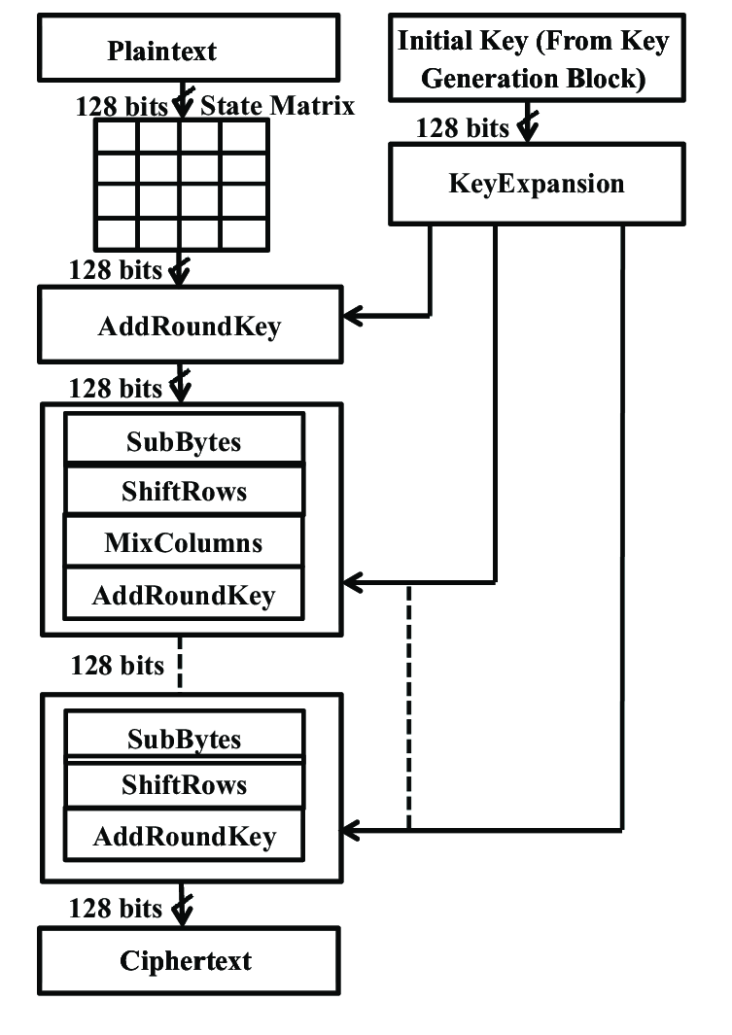
Pre-round of AES
Last round of AES

Slide 9
Key expansion in AES
For each round in AES requires different key for the addition to the input text. So, the given input key is used to generate key for its next round.
The given input key is divided into blocks and the 4th word(1 word = 32 bits) of the key is passed into G-Function and the output is XOR-ed with 1st word of input key to generate the 1st word of required key, this 1st word of the required key is XOR-ed with the 2nd word of the input key that gives the 2nd word of the required key, this 2nd word of the required key is XOR-ed with the 2nd word of the input key that gives the 3rd word of the required key and for the 4th word is done similarly.
And the keys of all the rounds are produced using the previous round key.

Slide 10
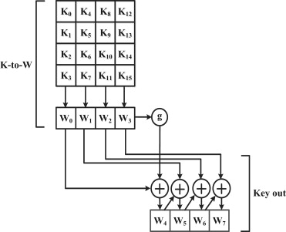
Key expansion in AES

Slide 11
G-Function
The G-Function in the process of key expansion has 3 steps
Rotation word.
Substitution of bytes(S-box).
XOR operation with RoundConstant.
Rotation word
The Rot word operation is the left shift of data by each byte(or 1 element).
Example:
Input data : b1, b2, b3, b4
Output data : b2, b3, b4, b1

Slide 12
G-Function
Substitution of Bytes
Each byte in the output of the Rot word is substituted with some fixed values with the help of Rijndael S-box. This part of substitution of bytes will be is discussed in the upcoming slides.
Example:
Input : 00 1F 0E 54
Output : 63 C0 AB 20
3) XOR operation with RoundConstant
For each round the value of the round constant pre-declared. The XOR operation is done with the round constant depending on the round and with the output of the Substitution of Bytes.
Example:
Input : 01 02 03 04
Round constant : 01 00 00 00
Output: 00 02 03 04

Slide 13
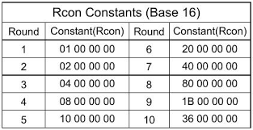
Round Constants (rcon)
As shown in the above for the process of key expansion each round has a pre-defined rconstant values.

Slide 14
Input data Division and Conversion
The given plaintext is converted to hexa-decimal code with the help of ASCI values. This hexa-decimal code is divided into blocks as shown.
Input data :
Hexa-decimal :
Division of data:
T | H | A | T | S |  | M | Y |  | K | U | N | G |  | F | U
54 | 68 | 61 | 74 | 73 | 20 | 6d | 79 | 20 | 4b | 75 | 6e | 67 | 20 | 46 | 75
54 | 73 | 20 | 67
68 | 20 | 4b | 20
61 | 6d | 75 | 46
74 | 79 | 6e | 75

Slide 15
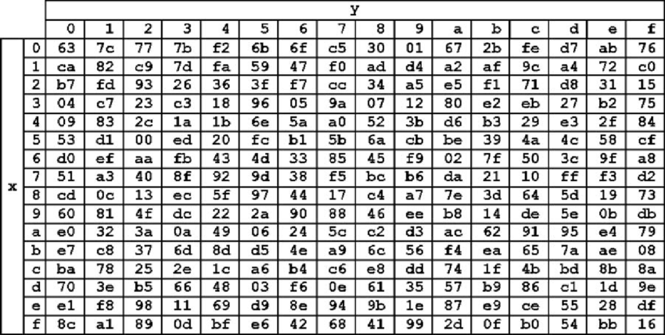
Substitution of bytes
Rijndael S-box
Every byte of the input text is substituted with their respective values as mentioned in Rijndael S-box of encryption.
The byte “xy” is replaced with the value corresponding to it in S-box. An example of S-box operation is shown in next slide.

Slide 16
Substitution of bytes
Rijndael S-box
Input data:
54 | 73 | 20 | 67
68 | 20 | 4b | 20
61 | 6d | 75 | 46
74 | 79 | 6e | 75
Output data:
20 | 8f | b7 | 85
45 | b7 | b3 | b7
ef | 3c | 9d | 5a
92 | b6 | 9f | 9d

Slide 17
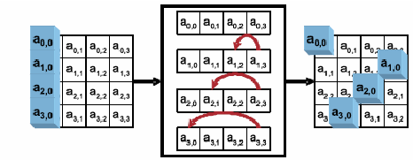
Shift-Rows
It is one of the easiest step in the round.
In the shift-row operation there is no change in 1st row, 2nd row is left-shifted by 1 byte, 3rd row is left-shifted by 2 bytes and the last row is shifted by 3 bytes.

Slide 18
Shift-Rows
Input data:
20 | 8f | b7 | 85
45 | b7 | b3 | b7
ef | 3c | 9d | 5a
92 | b6 | 9f | 9d
Output data:
20 | 8f | b7 | 85
b7 | 45 | b7 | b3
9d | 5a | ef | 3c
9d | 92 | b6 | 9f

Slide 19
Mix-Column
For the process of mix-column is the multiplication of the input matrix with a pre-defined matrix.
The step multiplication of matrices involves addition and multiplication of the numbers. These addition and multiplication are done using Galio’s-field addition and multiplication.
Galio’s field Addition
Galio’s field addition is the XOR operation between two operands.
Example:
1 + 1 = 1 xor 1 = 0
Galio’s field Multiplication
The two operands are converted into a polynomial with the help their bit number (index numbers) and multiplied.

Slide 20
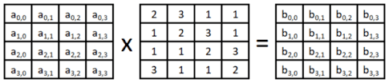
Mix-Column
Example :
21 * 3 = (00100001)*(00000011) = (x⁵+1)*(x+1) = x⁶+x⁵+x+1 = 01100011 = 63
Pre-defined matrix for mix-column

Slide 21
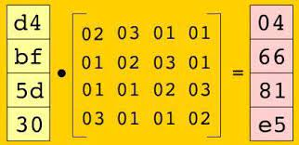
Mix-Column
An example for mix column operation:
In the same way all other columns are multiplied with the pre-defined matrix

Slide 22

Add Round-key
This is the last step in the Round. It takes two inputs input text and the key respective to the round.
The addition of round key is the XOR operation of round key and the input data.
Example:
Input Data:
54 | 77 | 6F | 20 | 4F | 6E | 65 | 20 | 4E | 69 | 6E | 65 | 20 | 54 | 77 | 6F
Round key:
54 | 68 | 61 | 74 | 73 | 20 | 6D | 79 | 20 | 4B | 75 | 6E | 67 | 20 | 46 | 75
output Data:
00 | 1F | 0E | 54 | 3C | 4E | 08 | 59 | 6E | 22 | 1B | 0B | 47 | 74 | 31 | 1A

Slide 23

AES Algorithm Code
This below link contains the code for AES using a Hardware Description Language, VHDL.
Link: https://drive.google.com/file/d/1uqqLzBcxPwK2CwVq78ZAW1cuRHniqmw9/view?usp=sharing
Write the test bench for the code and simulate it.
This below link contains the code that I have done using VHDL and Xilinx software you can download the file and simulate the file tb_AES_encryption.
Link:
https://drive.google.com/drive/folders/1rdITrWheWcLwvJIWOWz3BYJM3VGot9NR?usp=sharing

Slide 24

Thank you

